Slide 1
Deep Generative Models for Natural Images
Adam Anderson
Mentor: Matt Whiteway
UMD Directed Reading Program
Spring 2017

Slide 2
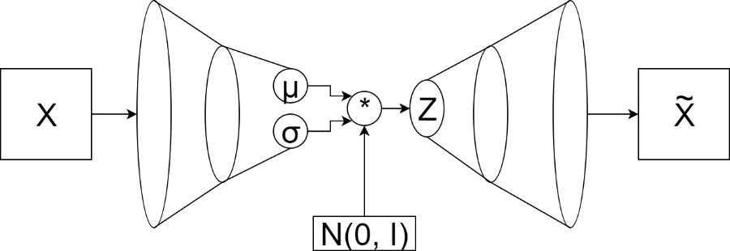
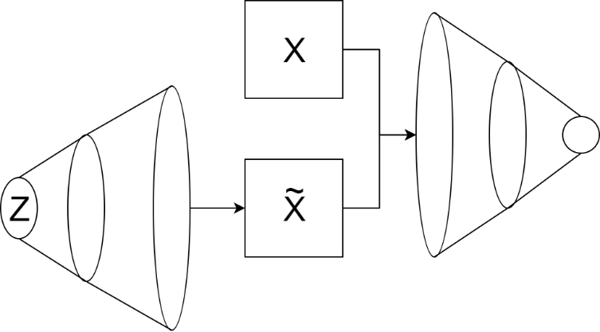
Agenda
Latent Variable Models
Neural Networks
Variational Autoencoder
Generative Adversarial Network

Slide 3
Latent Variable Models

Slide 4

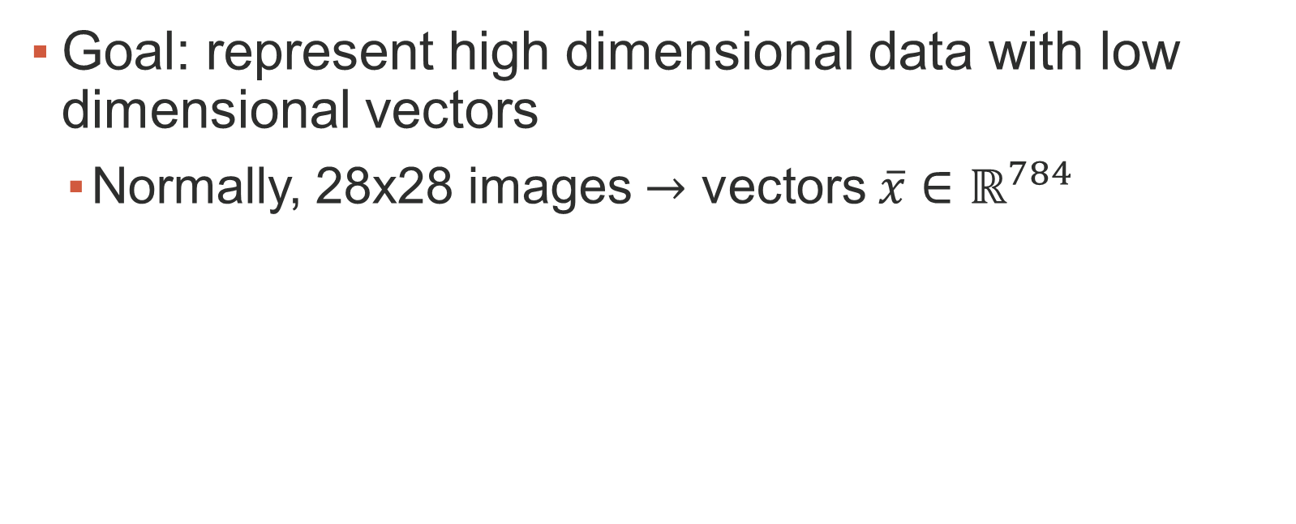
Latent Variable Models
Goal: represent high dimensional data with low dimensional vectors
Normally, 28x28 images $→$ vectors $\overline{x}∈ℝ^{784}$

Slide 5
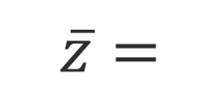
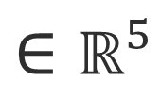
Latent Variable Models
Number (0-9)
X-translation
Y-translation
Rotation
Thickness
$$\overline{z}=$$
$$∈ℝ^{5}$$
8
0.5
0
5
5
9
0
-5
10
5
8
0
0
0
3

Slide 6
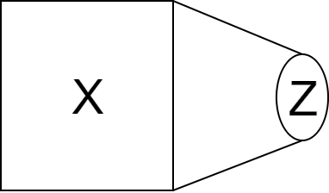
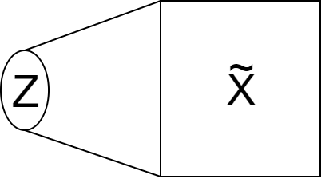
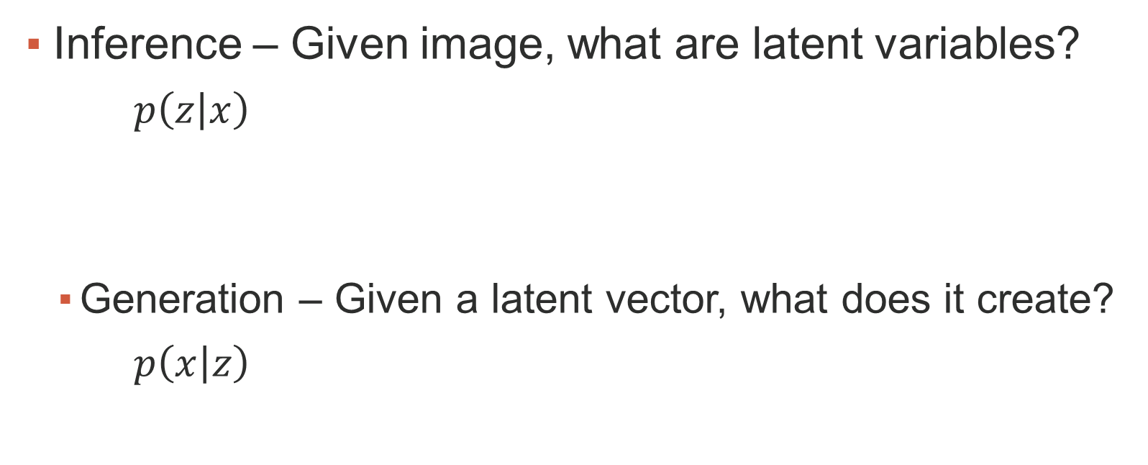
Latent Variable Models
Inference – Given image, what are latent variables?
$p\left(\left.z\right|x\right)$
Generation – Given a latent vector, what does it create?
$p\left(\left.x\right|z\right)$

Slide 7
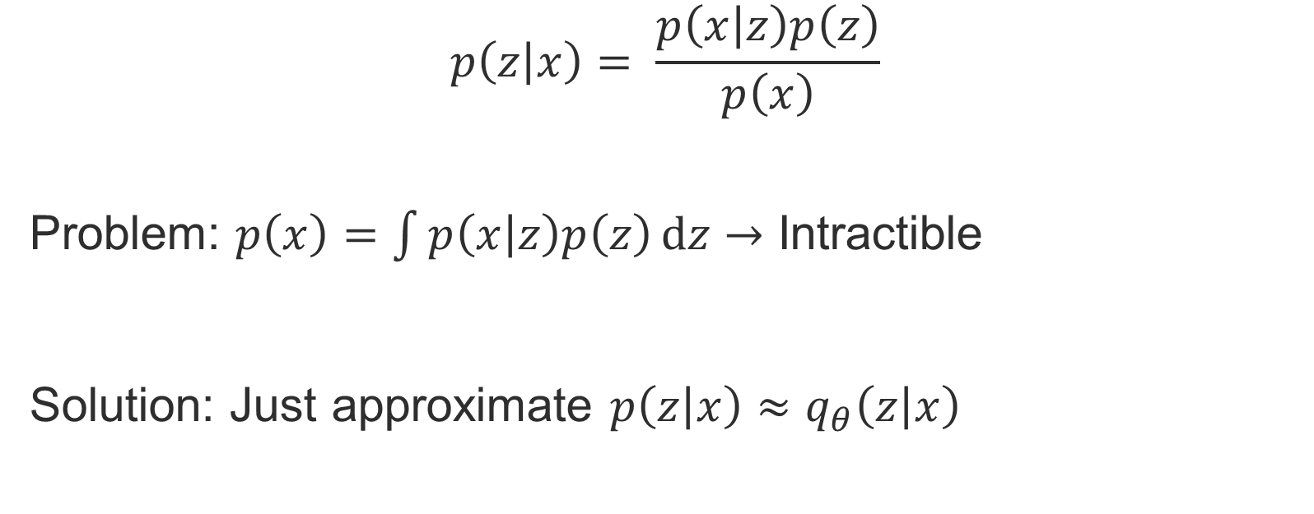
Latent Variable Models
$$p\left(\left.z\right|x\right)= \frac{p\left(\left.x\right|z\right)p\left(z\right)}{p\left(x\right)}$$
Problem: $p\left(x\right)=\int{p\left(\left.x\right|z\right)p\left(z\right)ⅆz}→$ Intractible
Solution: Just approximate $p\left(\left.z\right|x\right)≈q_{θ}\left(\left.z\right|x\right)$

Slide 8
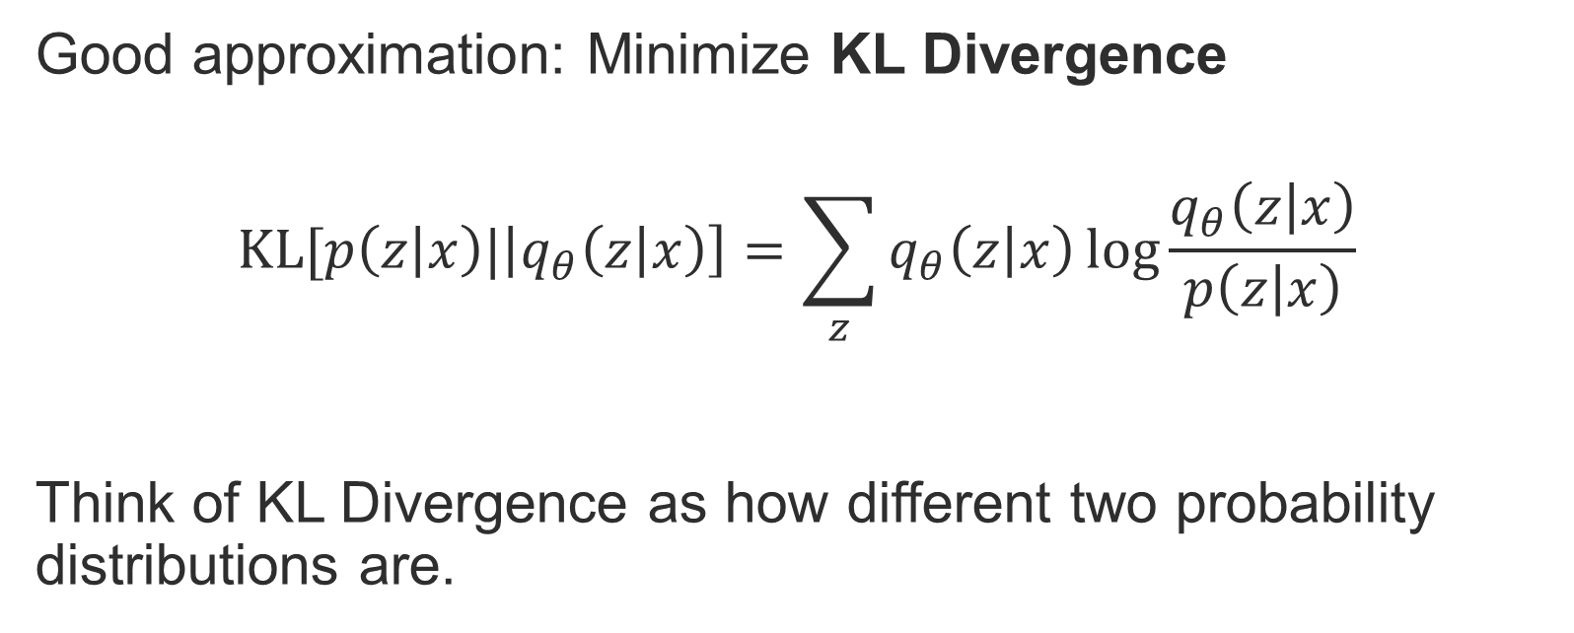
Latent Variable Models
Good approximation: Minimize KL Divergence
$$KL[p\left(\left.z\right|x\right)|\left|q_{θ}\left(\left.z\right|x\right)\right]=\sum_{z}{q_{θ}\left(\left.z\right|x\right)\log{\frac{q_{θ}\left(\left.z\right|x\right)}{p\left(\left.z\right|x\right)}}}$$
Think of KL Divergence as how different two probability distributions are.

Slide 9
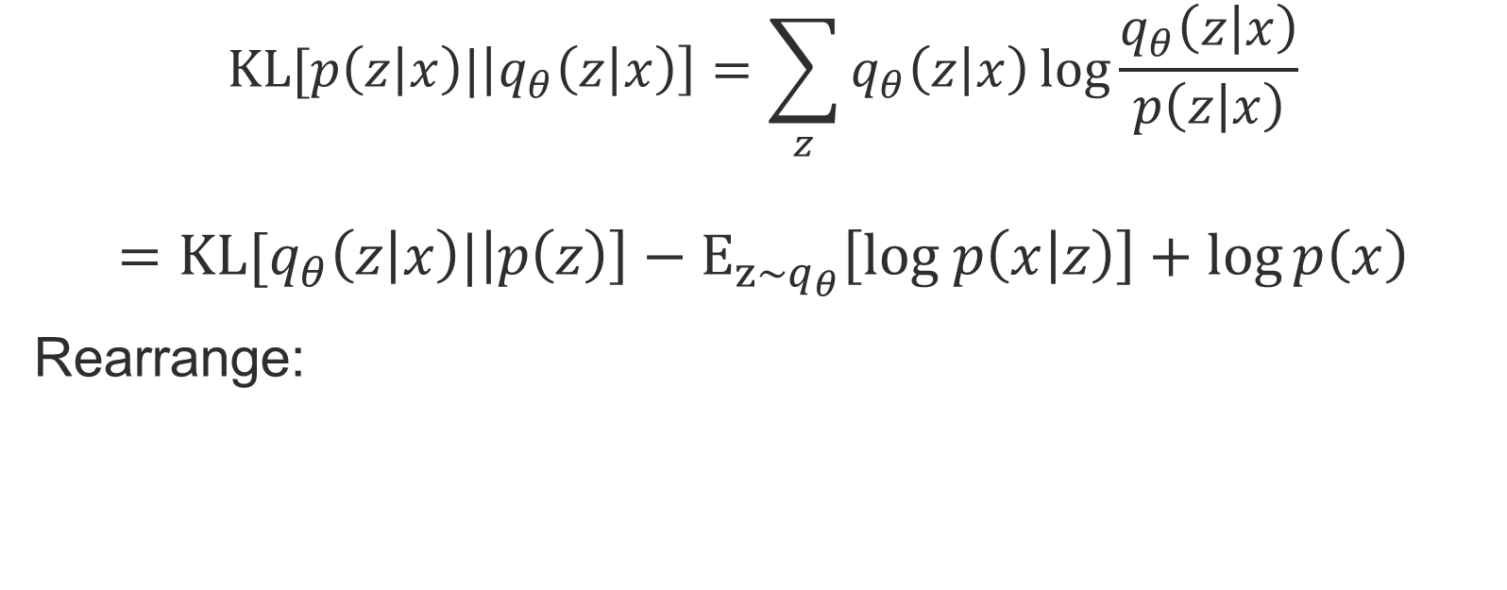
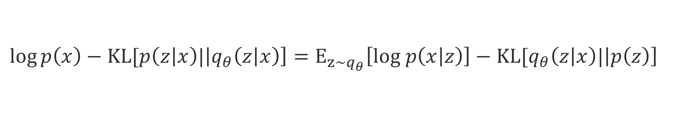
Latent Variable Models
$$KL[p\left(\left.z\right|x\right)|\left|q_{θ}\left(\left.z\right|x\right)\right]=\sum_{z}{q_{θ}\left(\left.z\right|x\right)\log{\frac{q_{θ}\left(\left.z\right|x\right)}{p\left(\left.z\right|x\right)}}}$$
$$={KL[q}_{θ}\left(\left.z\right|x\right)|\left|p\left(z\right)\right]−E_{z\sim q_{θ}}\left[log p\left(\left.x\right|z\right)\right]+\log{p\left(x\right)}$$
Rearrange:
$$\log{p\left(x\right)}−KL[p\left(\left.z\right|x\right)|\left|q_{θ}\left(\left.z\right|x\right)\right]=E_{z\sim q_{θ}}\left[log p\left(\left.x\right|z\right)\right]−{KL[q}_{θ}\left(\left.z\right|x\right)|\left|p\left(z\right)\right]$$

Slide 10
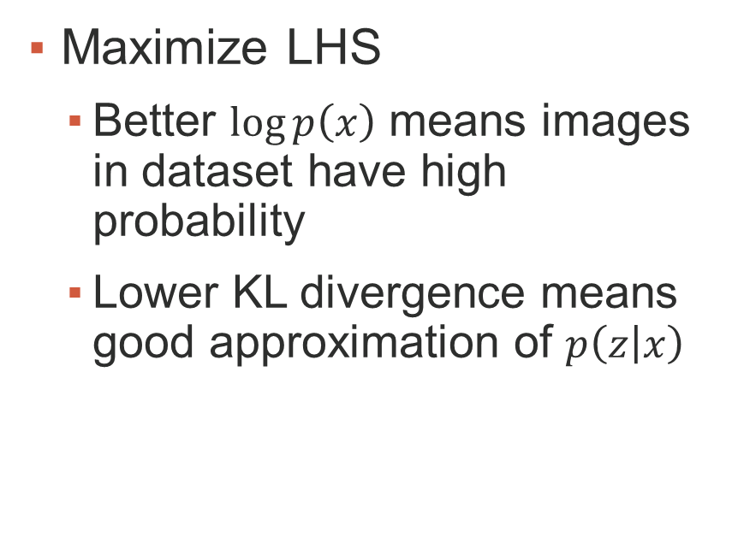
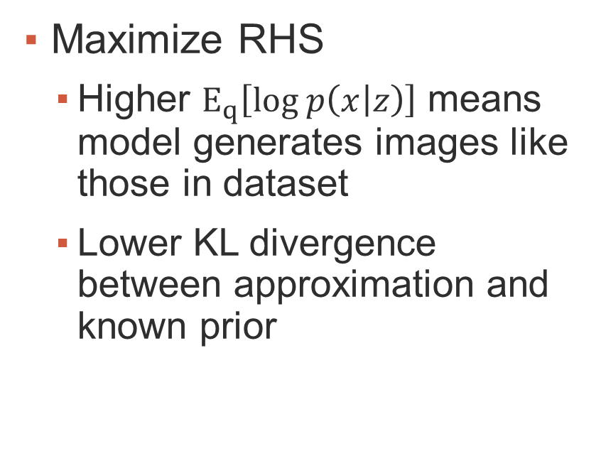

$$\log{p\left(x\right)}−KL[p\left(\left.z\right|x\right)|\left|q_{θ}\left(\left.z\right|x\right)\right]=E_{z\sim q_{θ}}\left[log p\left(\left.x\right|z\right)\right]−{KL[q}_{θ}\left(\left.z\right|x\right)|\left|p\left(z\right)\right]$$
Maximize LHS
Better $\log{p\left(x\right)}$ means images in dataset have high probability
Lower KL divergence means good approximation of $p\left(\left.z\right|x\right)$
Maximize RHS
Higher $E_{q}\left[log p\left(\left.x\right|z\right)\right]$ means model generates images like those in dataset
Lower KL divergence between approximation and known prior

Slide 11
Neural Networks

Slide 12
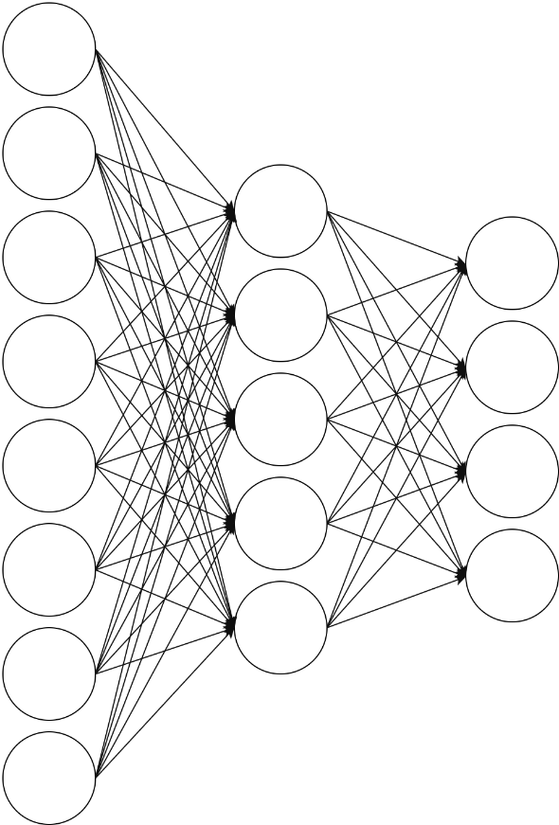
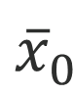
Neural Networks
Weight on activation going into node in next layer
$${\overline{x}}_{0}$$
W₂
Weight on activation coming from node in previous layer
W₁

Slide 13
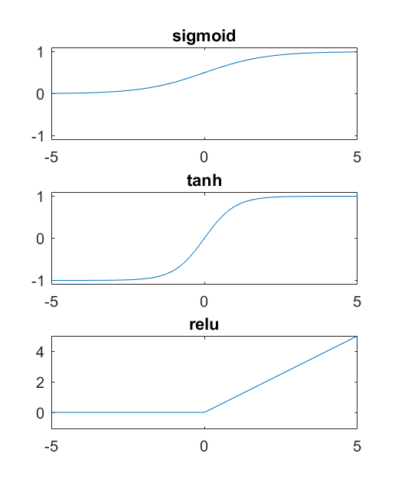
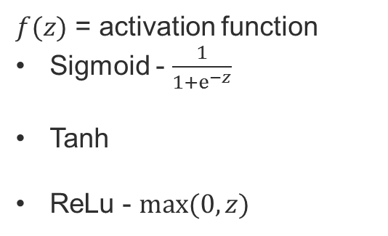
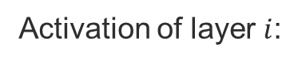

Neural Networks
Activation of layer $i$:
$$\overline{x_{i}}=f(W_{i}{\overline{x}}_{i−1})$$
$f(z)$ = activation function
Sigmoid - $\frac{1}{1+ⅇ^{−z}}$
Tanh
ReLu - $max⁡(0, z)$
$${\overline{x}}_{0}$$
W₂
W₁

Slide 14
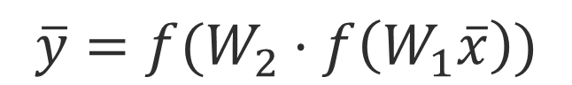
Neural Networks
$${\overline{x}}_{0}$$
$$\overline{y}=f(W_{2}⋅f\left(W_{1}\overline{x}\right))$$
W₂
W₁

Slide 15
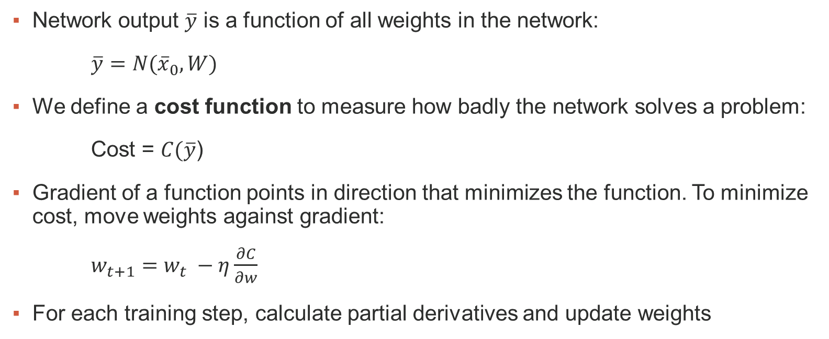
Neural Networks
Network output $\overline{y}$ is a function of all weights in the network:
$\overline{y}=N({\overline{x}}_{0}, W)$
We define a cost function to measure how badly the network solves a problem:
Cost = $C(\overline{y}$)
Gradient of a function points in direction that minimizes the function. To minimize cost, move weights against gradient:
$w_{t+1}=w_{t} −η\frac{∂C}{∂w}$
For each training step, calculate partial derivatives and update weights

Slide 16
Variational Autoencoders

Slide 17

Variational Autoencoder
Regular autoencoder:
Project input to low dimension, project back to higher dimension

Slide 18
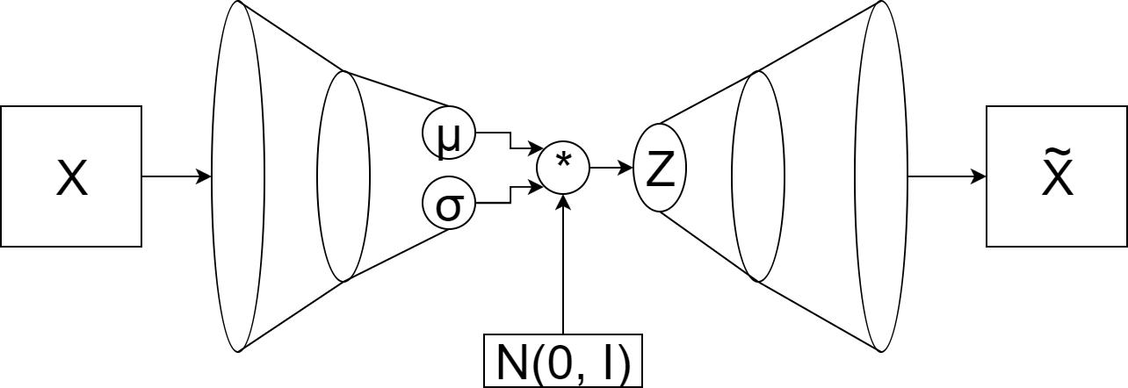
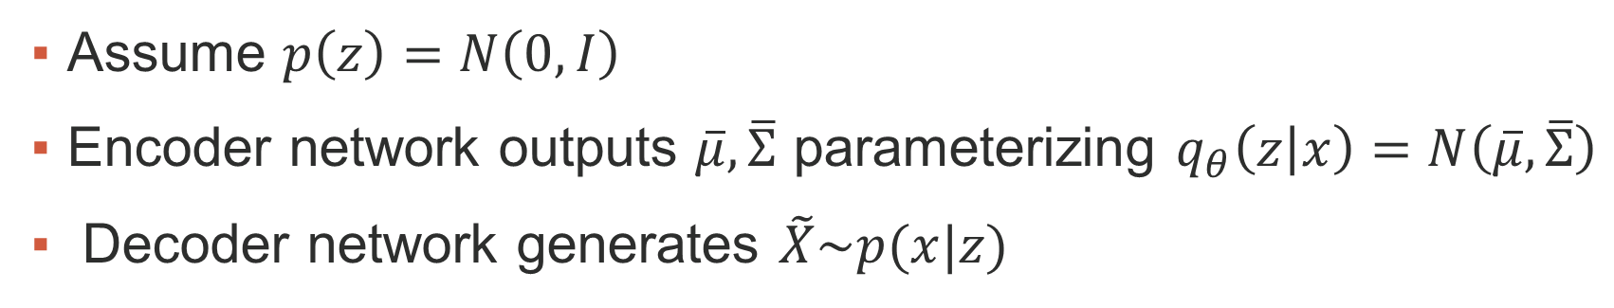

Variational Autoencoder
$$\log{p\left(x\right)}−KL[p\left(\left.z\right|x\right)|\left|q_{θ}\left(\left.z\right|x\right)\right]=E_{z\sim q_{θ}}\left[log p\left(\left.x\right|z\right)\right]−{KL[q}_{θ}\left(\left.z\right|x\right)|\left|p\left(z\right)\right]$$
Assume $p\left(z\right)=N\left(0, I\right)$
Encoder network outputs $\overline{μ}, \overline{Σ}$ parameterizing $q_{θ}\left(\left.z\right|x\right)=N\left(\overline{μ}, \overline{Σ}\right)$
Decoder network generates $\tilde{X}\sim p(x|z)$

Slide 19
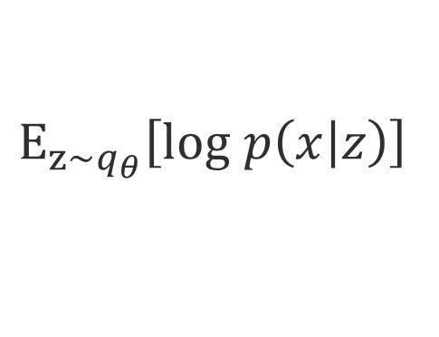
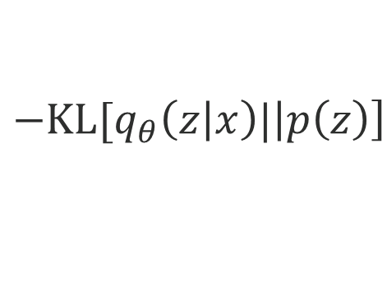
$$E_{z\sim q_{θ}}\left[log p\left(\left.x\right|z\right)\right]$$
$${−KL[q}_{θ}\left(\left.z\right|x\right)|\left|p\left(z\right)\right]$$
KL divergence tries to make latent vectors ~ independent unit Gaussian
Expectation tries to make outputs look like inputs

Slide 20
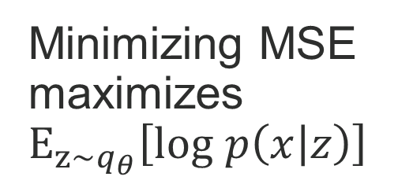
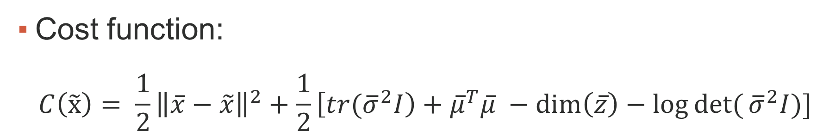
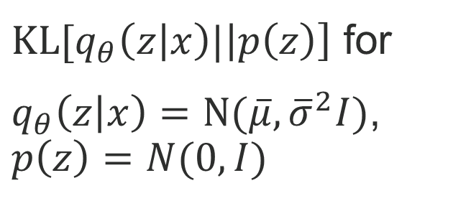
Variational Autoencoder
Cost function:
$$C\left(\tilde{x}\right)= \frac{1}{2}{\left\|\overline{x}−\tilde{x}\right\|}^{2}+\frac{1}{2}\left[{tr(\overline{σ}}^{2}I\right)+{\overline{μ}}^{T}\overline{μ} −\dim\left(\overline{z}\right)−\log{det⁡(}{\overline{σ}}^{2}I)]$$
Minimizing MSE maximizes $E_{z\sim q_{θ}}\left[log p\left(\left.x\right|z\right)\right]$
${KL[q}_{θ}\left(\left.z\right|x\right)|\left|p\left(z\right)\right]$ for
$q_{θ}\left(\left.z\right|x\right)=N(\overline{μ}, {\overline{σ}}^{2}I)$,
$$p\left(z\right)=N(0, I)$$

Slide 21
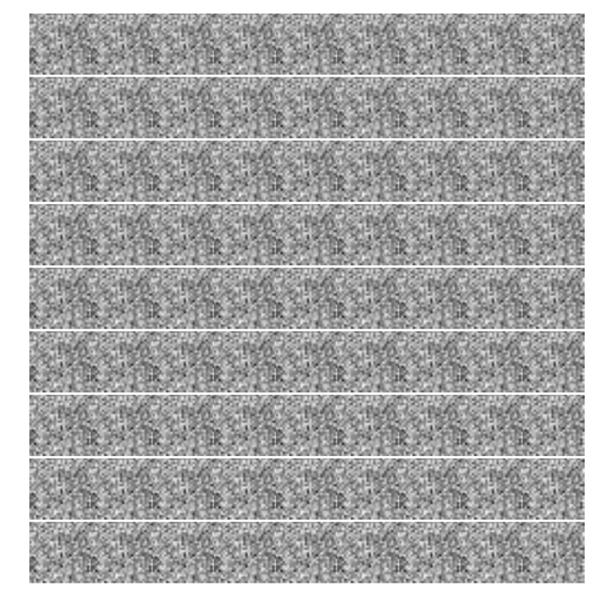

Slide 22
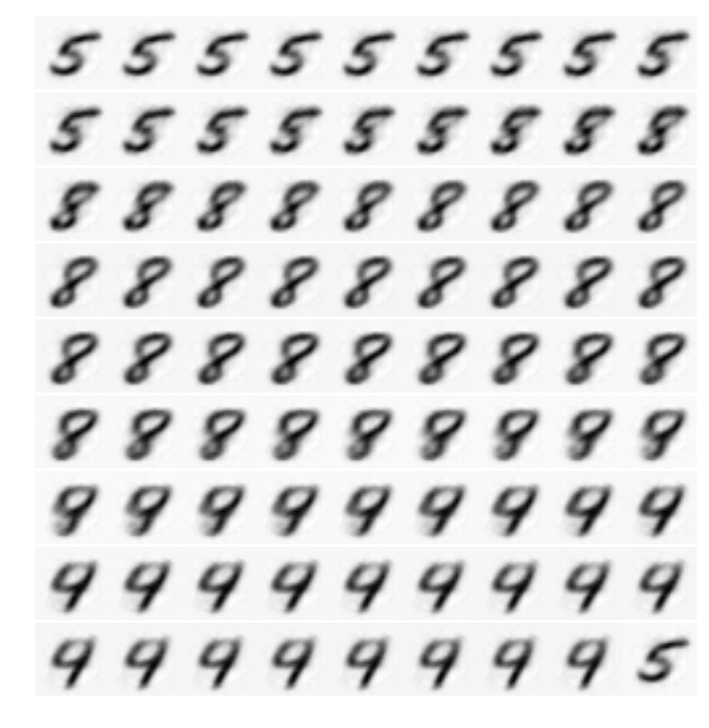

Slide 23
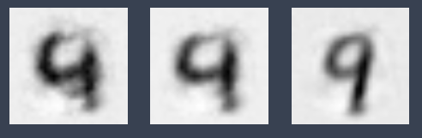






Slide 24
Generative Adversarial Networks

Slide 25
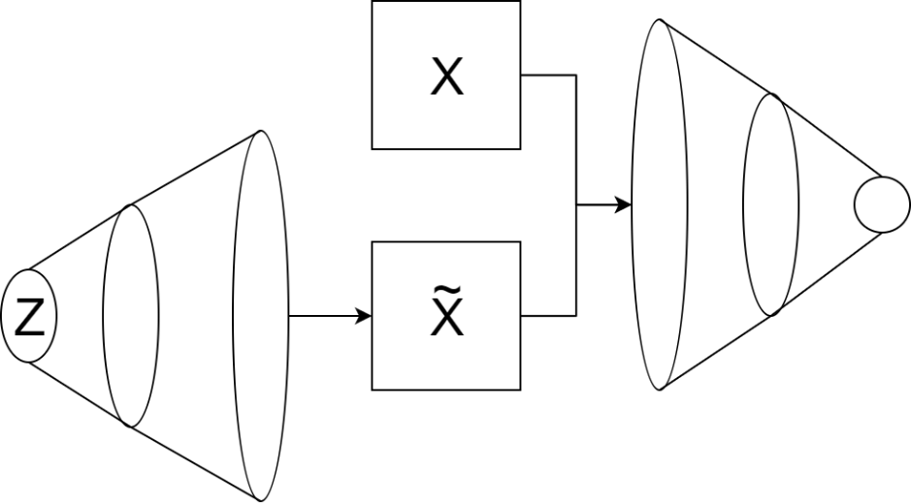
Generative Adversarial Networks
Generator Network
Create images from some prior distribution
Discriminator Network
Learn to recognize which images are from dataset, which are generated

Slide 26
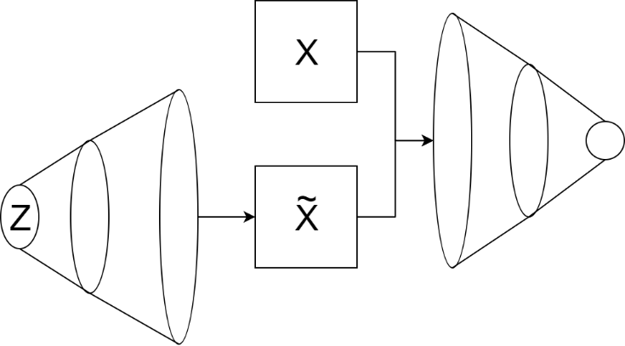
Generative Adversarial Networks
Generator learns to create images like those in dataset
Discriminator learns to recognize structure introduced by generator

Slide 27
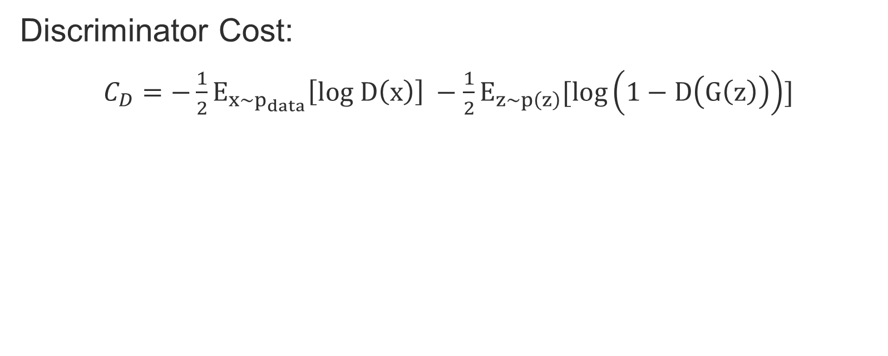
Generative Adversarial Networks
Discriminator Cost:
$C_{D}=−\frac{1}{2}E_{x\sim p_{data}}\left[log D\left(x\right)\right] −\frac{1}{2}E_{z\sim p\left(z\right)}[log\left(1−D\left(G\left(z\right)\right)\right)]$
Assign high probability to images from dataset
Assign low probability to generated images

Slide 28
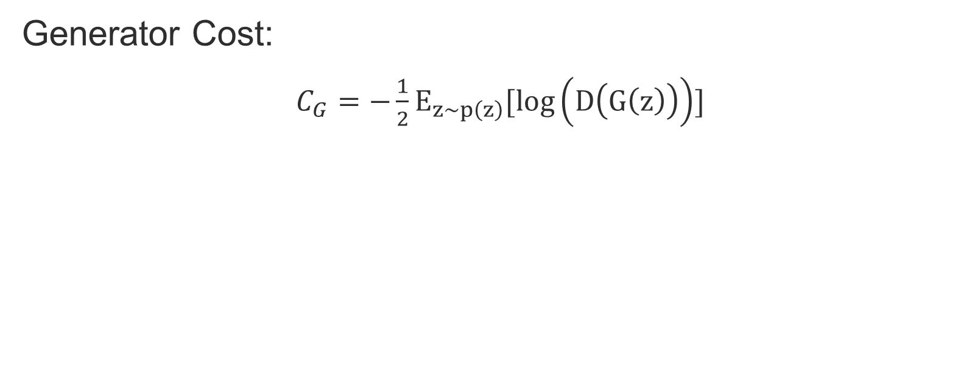
Generative Adversarial Networks
Generator Cost:
$C_{G}=−\frac{1}{2}E_{z\sim p\left(z\right)}[log\left(D\left(G\left(z\right)\right)\right)]$
Fool discriminator into assigning high probability to generated images

Slide 29







Slide 30
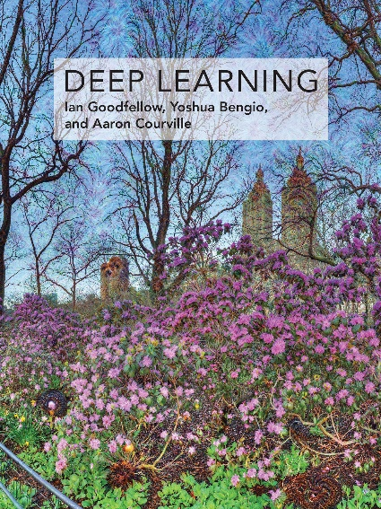
References
Deep Learning – Goodfellow, Bengio, Courville (2016).
Tutorial on Variational Autoencoders – Doersch (2016).
NIPS 2016 Tutorial: Generative Adversarial Networks – Goodfellow (2017).

